Slide 1


Department of Computer Science and Engineering
CA4: Mini Project
Data Science (0705210707)
Session: 2025-26
TITLE OF PROJECT - Vidya Insights: Transforming Educational Data into Actionable Insights
Presented By:
Name: Shreyas Kasture
PRN: 22070521032
Mentor:
Name: Dr. Piyush Chauhan
Designation: Associate Professor (Examination Incharge)
Department of Computer Science & Engineering
Symbiosis Institute of Technology, Nagpur Campus (SIT-N)

Slide 2

Presentation Outline:
Problem Statement
Dataset Overview
Data Structure and Indicators
Data Preprocessing
Exploratory Data Analysis (EDA)
Key Findings and Insights of EDA
Simple Linear Regression Plots
Multiple Linear Regression Plots
K-Means Clustering Plots
Classification Model Plots
Deep Learning Plots
Comparison of Model Results
Major Insights and Relationships
Collaborated Dataset Overview
Collaborated Dataset Insights
References

Slide 3
Problem Statement
In India’s vast and diverse educational landscape, ensuring uniform learning outcomes across regions remains a major challenge. The National Achievement Survey (NAS) highlights significant disparities in student performance across districts and states, with certain subjects and learning outcomes consistently underperforming despite national educational reforms. However, the current analysis often stops at descriptive statistics, lacking predictive foresight. There is a critical need for an intelligent, data-driven solution that can not only identify low-performing regions but also predict future student performance based on factors like the number of schools, students surveyed, past performance trends, and subject-specific competencies. By leveraging machine learning techniques on the NAS dataset, we can develop predictive models that forecast educational outcomes, uncover key drivers of performance gaps, and inform targeted interventions, ultimately helping policymakers, educators, and stakeholders design effective, evidence-based strategies to improve learning outcomes and bridge regional disparities in education.

Slide 4
Dataset Overview
The National Achievement Survey (NAS) is a large-scale assessment conducted across India to evaluate the learning outcomes of students in various classes. This dataset provides a detailed analysis of student performance in key subjects like Language, Mathematics, Science, and Social Science for class 3, 5 and 8.
It highlights areas where students are excelling and identifies gaps that need intervention. By analyzing trends and patterns in learning outcomes, this report supports the National Education Policy (NEP) 2020 in shaping targeted improvements in teaching methodologies It also aids in designing remedial measures to strengthen foundational literacy and numeracy, which are crucial for students' future academic success.
Dataset Profile
Data Published By: Ministry of Education
Sector: Education and Training
Dataset Hosted By: National Data and Analytics Platform (NDAP)
Geographical Coverage: State, District
Time Granularity: Yearly
Frequency: Yearly
Year Range: CY(Calendar Year) 2017 - CY (Calendar Year) 2021
Date Updated: July 09, 2025

Slide 5
Data Structure and Indicators
The dataset comprises 1405 rows, with the following structure:
Key Dimensions
Location:
Country (1 unique value)
State (36 unique values)
District (737 unique values)
Time:
Year (2 unique values)
Other Dimensions:
Class (1 unique value: Class 8)
Key Indicators
Number of schools surveyed: The count of schools that participated in the survey within a district.
Min: 8
Max: 1380
Mean: 223.14
Number of students surveyed: The total number of students who were assessed in a district.
Min: 96
Max: 36224
Mean: 5188.01
Average performance of students (%): The dataset contains dozens of indicators measuring the average performance (in percentage) on specific learning outcomes across different subjects. These are calculated as a weighted average based on the total population from the census. Performance varies significantly across different competencies and districts.

Slide 6
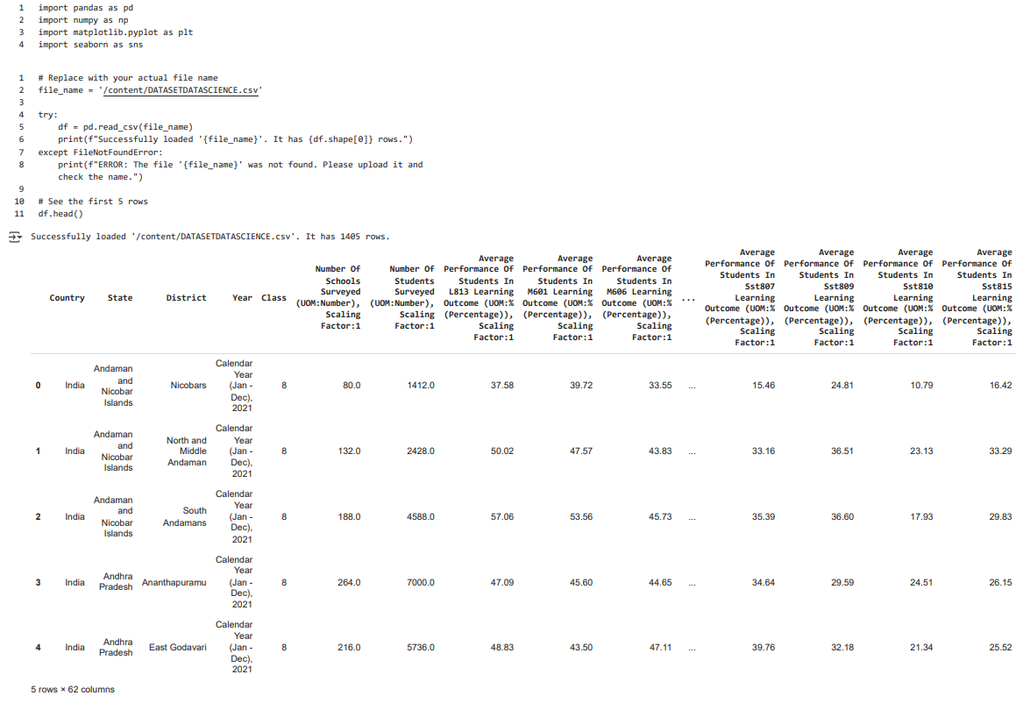
Data Preprocessing
Introduction
This project analyzes educational performance data across different districts and states in India. The dataset is based on Annual Status of Education Report (ASER) - like surveys, focusing on student learning outcomes in various subjects. This documentation outlines the process from data loading and cleaning to exploratory data analysis, with a specific focus on data from the Calendar Year 2021.
Data Loading
This section details how the raw data was loaded into a pandas DataFrame. The data was read from the CSV file named /content/DATASETDATASCIENCE.csv using the pd.read_csv function. The initial shape of the DataFrame and the first few rows were displayed to confirm successful loading and to get a preliminary look at the data structure.

Slide 7
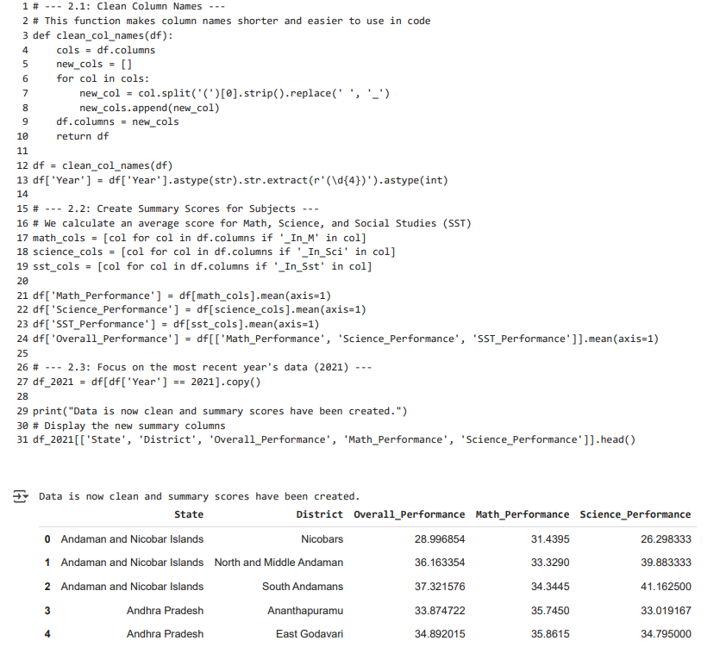
Data Preprocessing
Data Cleaning and Preparation
This section describes the crucial steps taken to prepare the data for analysis:
Cleaning Column Names: A custom function clean_col_names was used to simplify the long and complex column names by removing parenthetical information and replacing spaces with underscores. This makes the columns easier to reference in code.
Extracting Year: The year was extracted from the 'Year' column, which contained descriptive text, and converted into an integer format for easier filtering and analysis.
Creating Summary Scores: Average performance scores were calculated for key subjects (Math, Science, and Social Studies - SST) by averaging the scores across the various learning outcome columns related to each subject.
Calculating Overall Performance: An 'Overall_Performance' score was computed for each district by taking the average of the Math, Science, and SST summary scores.
Filtering for 2017-21 Data: The analysis was focused specifically on the data from the year 2017-2021 by creating a new DataFrame df_2021, which is a subset of the cleaned data.

Slide 8
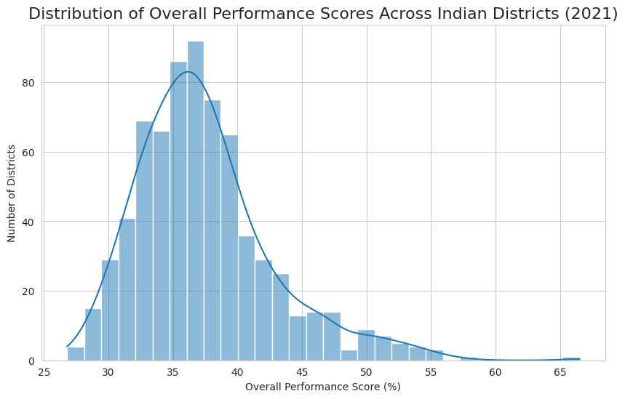
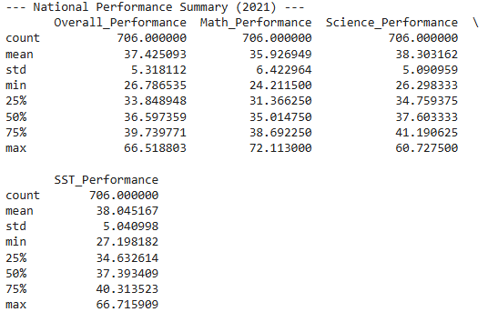
Exploratory Data Analysis (EDA)
This section presents the initial exploration and visualization of the prepared data:
National Summary Statistics: Descriptive statistics (.describe()) were calculated and displayed for the overall and subject-specific performance scores across all districts in 2021, providing a national overview of performance metrics (mean, standard deviation, min, max, quartiles).
Distribution of Overall Performance: A histogram with a Kernel Density Estimate (KDE) plot was generated to visualize the distribution of 'Overall_Performance' scores across districts, showing the frequency of different performance levels.

Slide 9
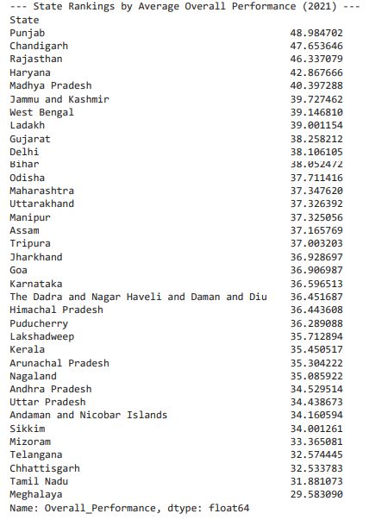
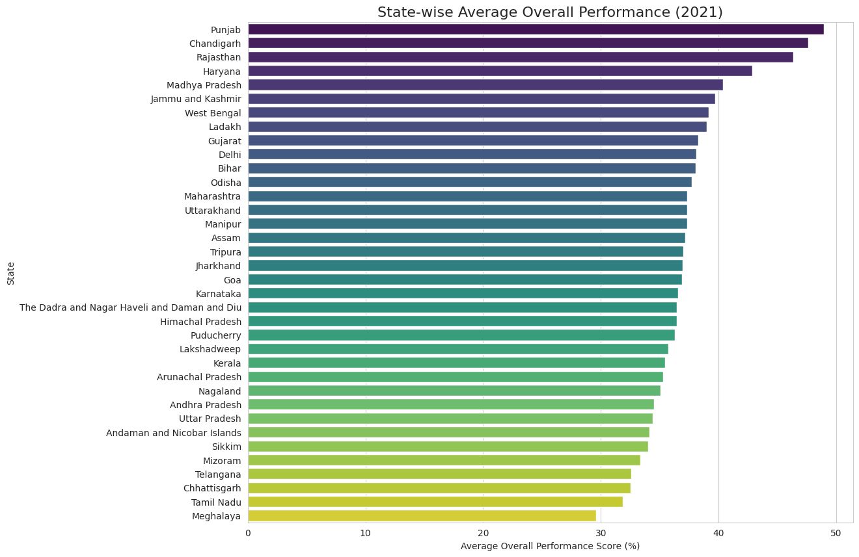
Exploratory Data Analysis (EDA)
Univariate Analysis:
State-level Performance Ranking: The average 'Overall_Performance' was calculated for each state, and the states were ranked based on these averages.
Visualization of State Rankings: A horizontal bar chart was created to visually compare the average overall performance across different states, highlighting the states with the highest and lowest average scores.

Slide 10
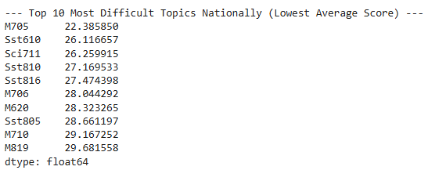
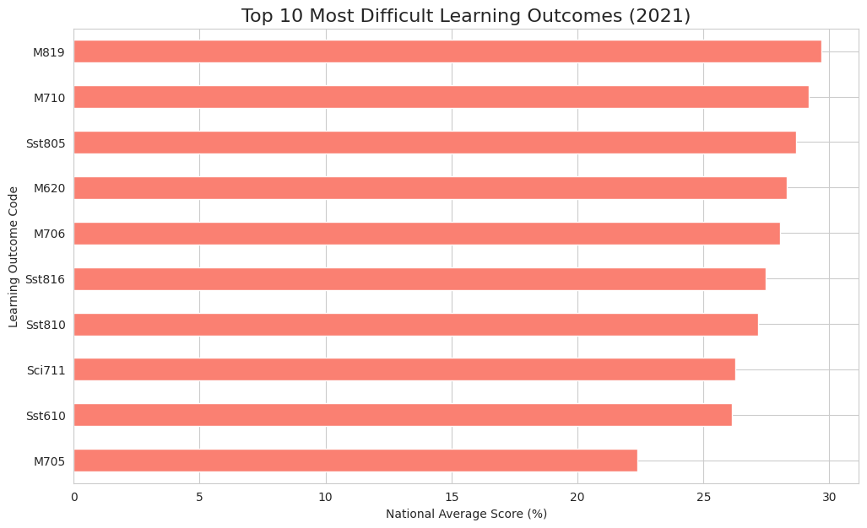

Exploratory Data Analysis (EDA)
Bivariate Analysis:
Identifying Most Difficult Topics: The 10 learning outcomes with the lowest national average scores were identified as the most difficult topics and presented in a table.
Visualization of Most Difficult Topics: A horizontal bar chart was plotted to visually represent the national average scores for the top 10 most difficult learning outcomes, making it easy to compare their relative difficulty.

Slide 11
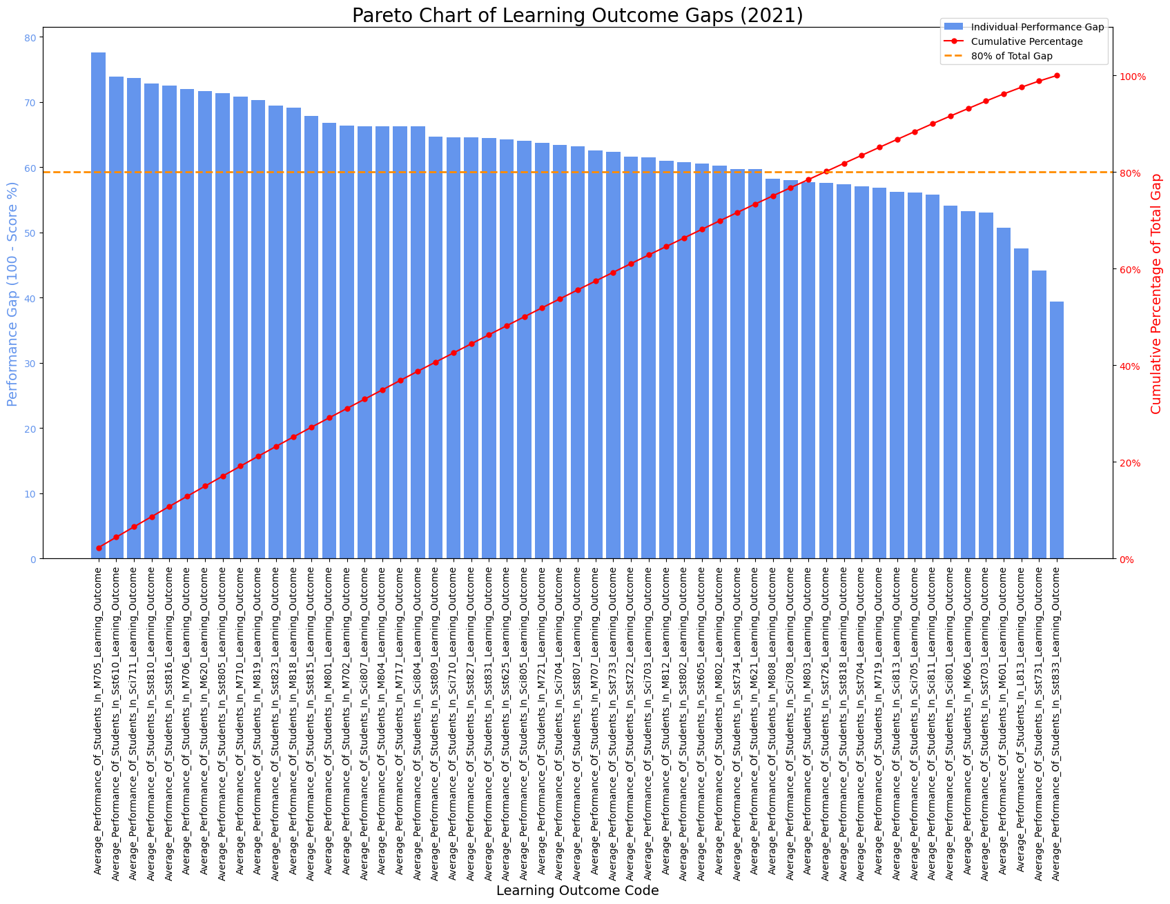
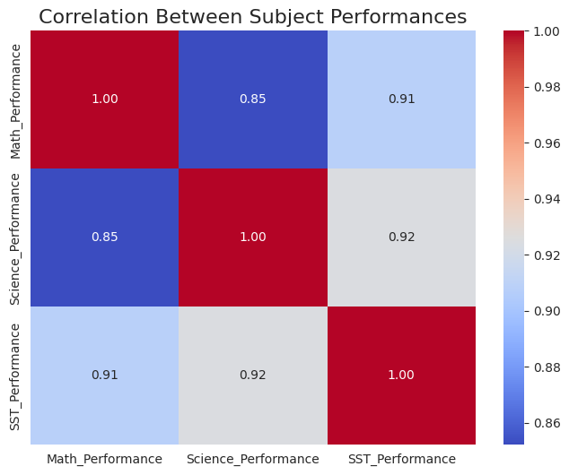
Exploratory Data Analysis (EDA)
Multivariate Analysis:
Visualization of Correlation Matrix: A heatmap was generated to visually represent the correlation matrix, showing the strength and direction of the relationships between subject scores.
A Pareto chart was used to visualize the cumulative performance gap across the most difficult learning outcomes, highlighting the few outcomes contributing most to the overall performance deficit.

Slide 12
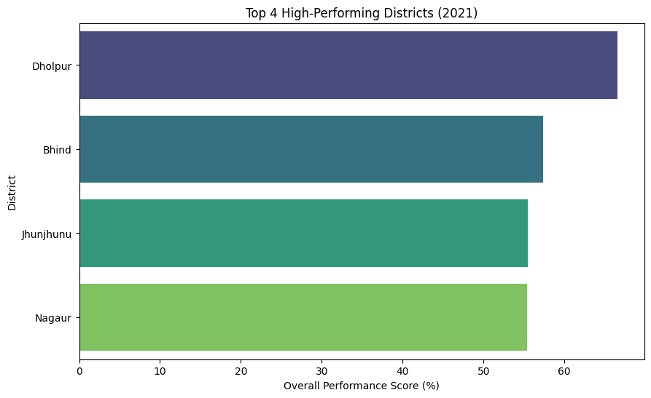
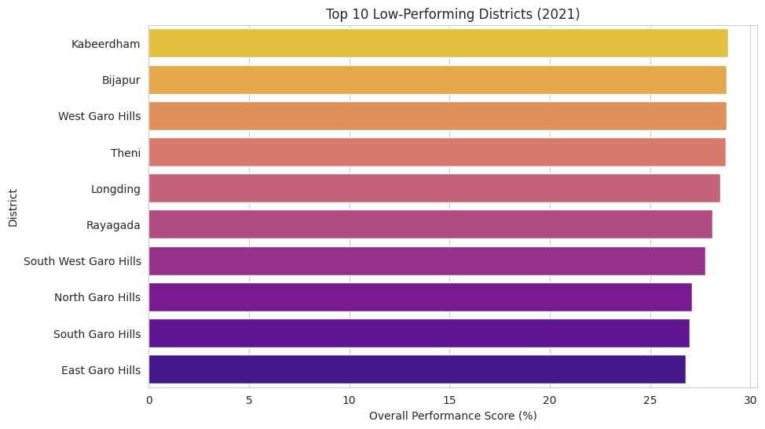
Key Findings and Insights of EDA
Based on the exploratory data analysis, several key insights were gained:
The national average overall performance and the variability across districts were observed from the summary statistics.
Significant differences in average performance exist across states, with some states consistently performing higher (e.g., Punjab) and others lower (e.g., Meghalaya).
Specific learning outcomes were identified as particularly challenging for students nationally.
There are strong positive correlations between performance in Math, Science, and SST, suggesting that districts where students perform well in one subject tend to perform well in others.
The analysis allowed for the identification of "bright spot" districts (high-performing outliers) and "hotspot" districts (low-performing outliers) that warrant further investigation.

Slide 13
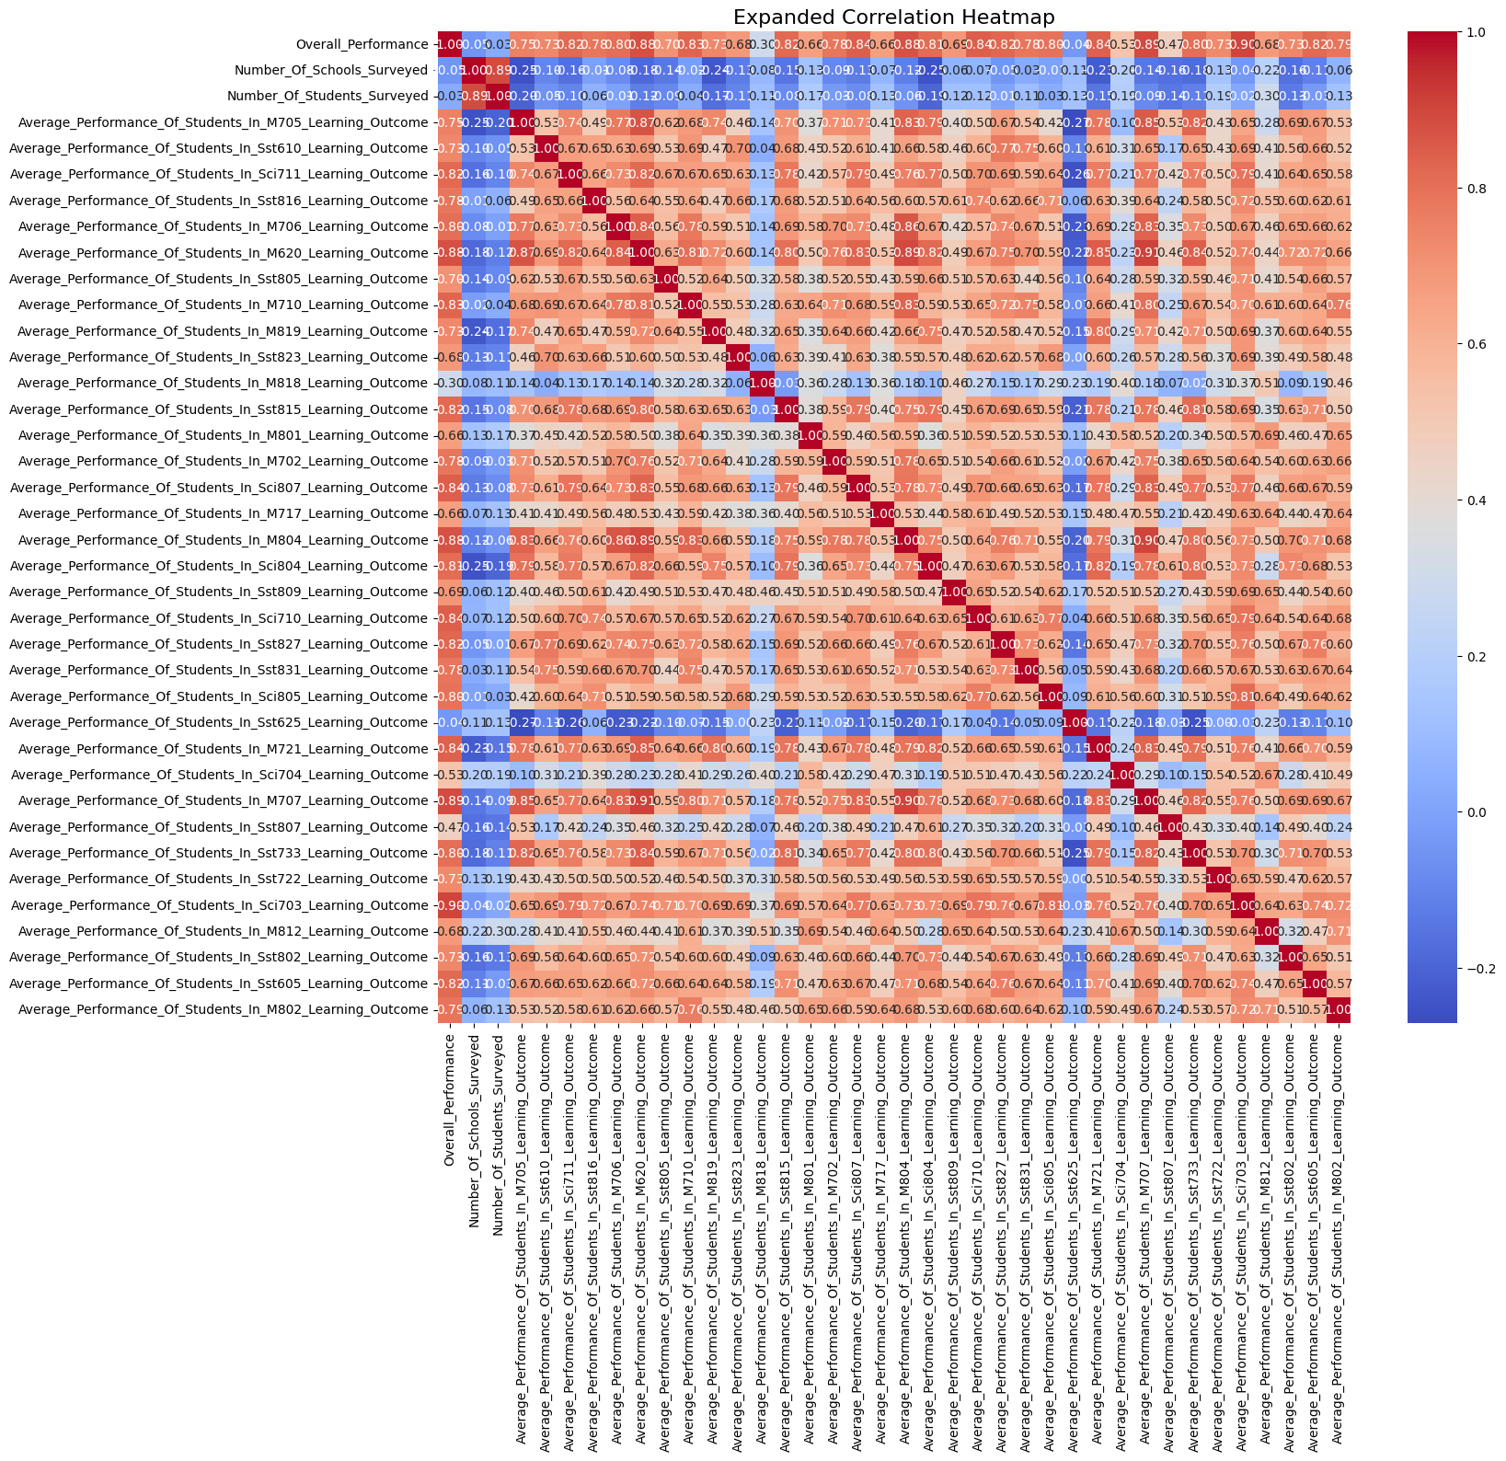
Key Findings and Insights of EDA
A heatmap showing the correlations between Overall Performance and a broad selection of individual Learning Outcomes as well as the Number of Schools/Students Surveyed. The intensity and hue of the color in each cell indicate the strength and direction of the correlation coefficient ($r$), ranging from strong positive (bright red, near +1.0) to strong negative (bright blue, near -1.0), with light colors indicating a weak correlation (near 0.0). The dominant pattern in the heatmap is the presence of widespread strong positive correlations (dark red) among the various "Average Performance" metrics, suggesting that student achievement is generally consistent across different academic areas. The heatmap is a powerful tool for quickly identifying closely linked academic areas and understanding the structure of performance drivers within the educational data.

Slide 14
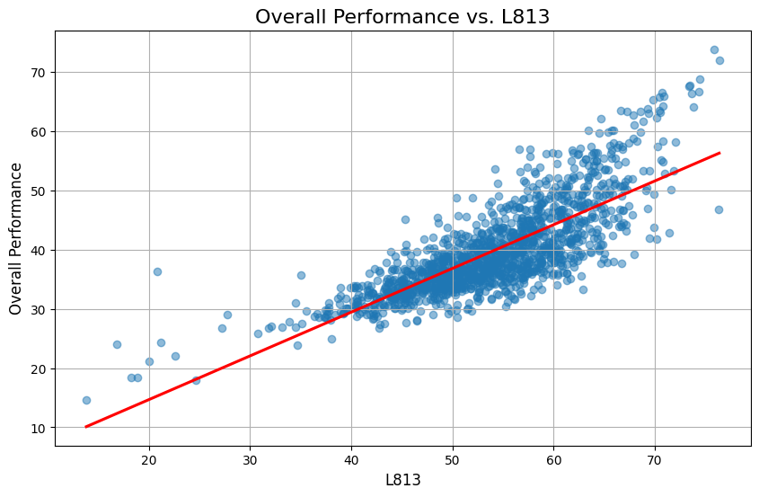
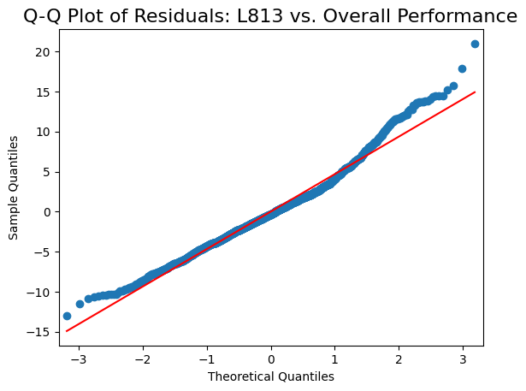
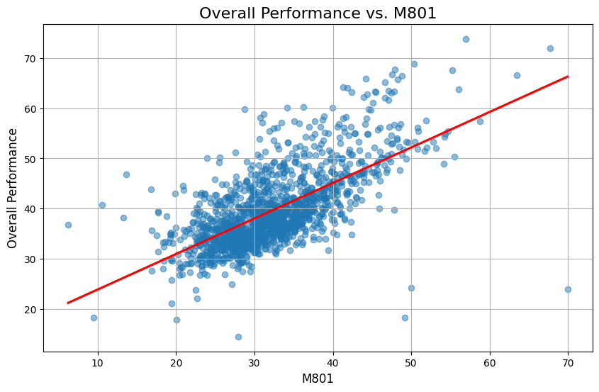
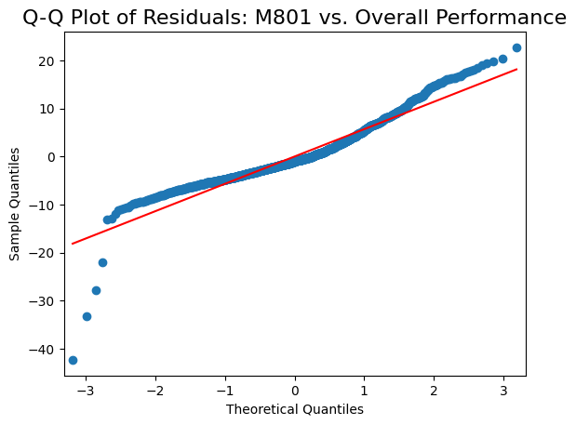
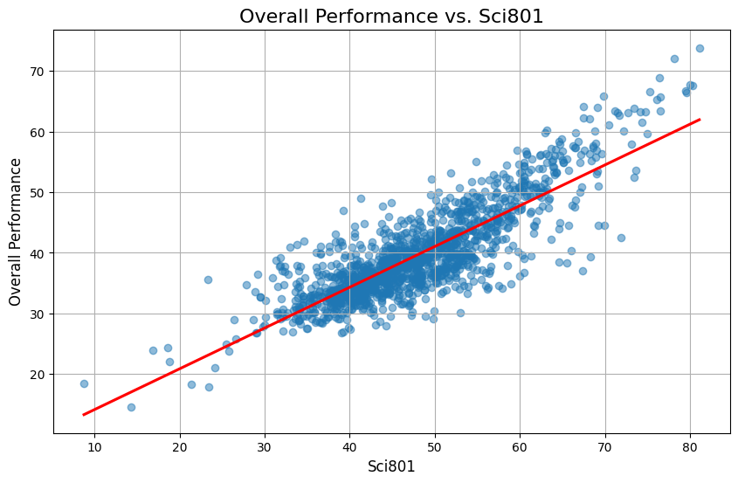
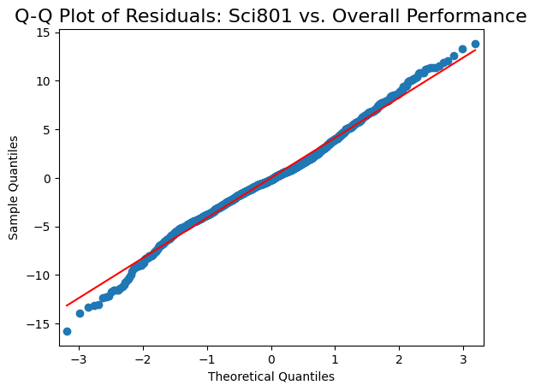
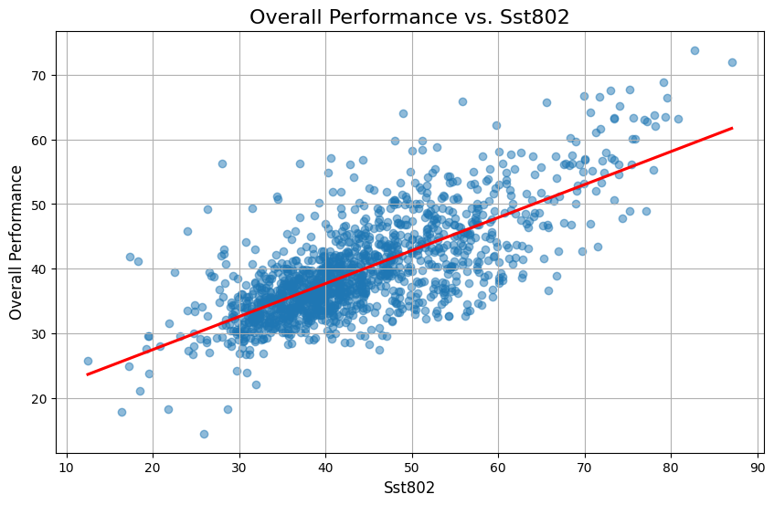
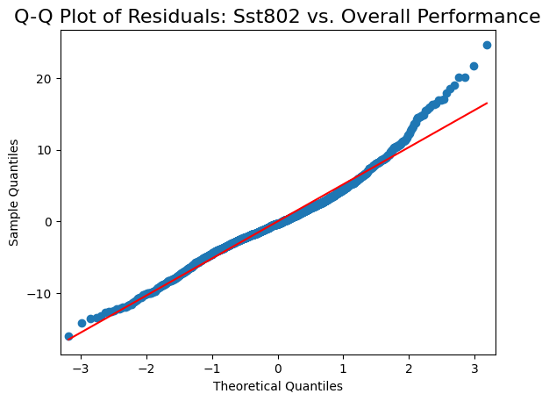
Simple Linear Regression Plots
Overall Performance vs. L813 - Shows the linear relationship between the L813 Learning Outcome and Overall Performance. Q-Q Plot of Residuals: L813 vs. Overall Performance - Checks the normality of the residuals for the regression model.
Overall Performance vs. M801 - Shows the linear relationship between the M801 Learning Outcome and Overall Performance. Q-Q Plot of Residuals: M801 vs. Overall Performance - Checks the normality of the residuals for the regression model.
Overall Performance vs. Sci801 - Shows the linear relationship between the Sci801 Learning Outcome and Overall Performance. Q-Q Plot of Residuals: Sci801 vs. Overall Performance - Checks the normality of the residuals for the regression model.
Overall Performance vs. Sst802 - Shows the linear relationship between the Sst802 Learning Outcome and Overall Performance. Q-Q Plot of Residuals: Sst802 vs. Overall Performance - Checks the normality of the residuals for the regression model.

Slide 15
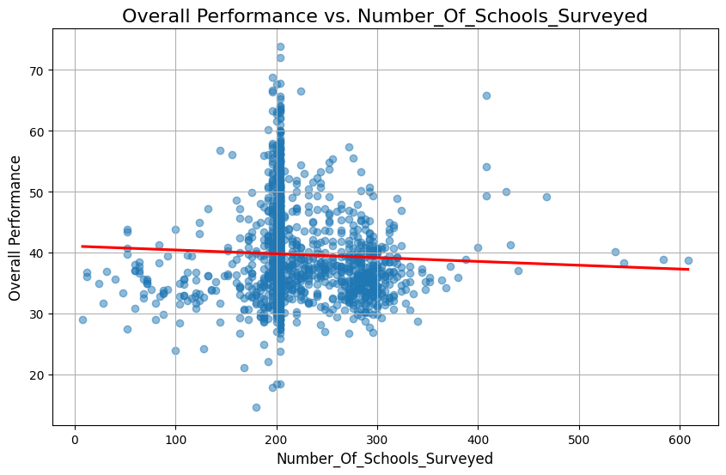
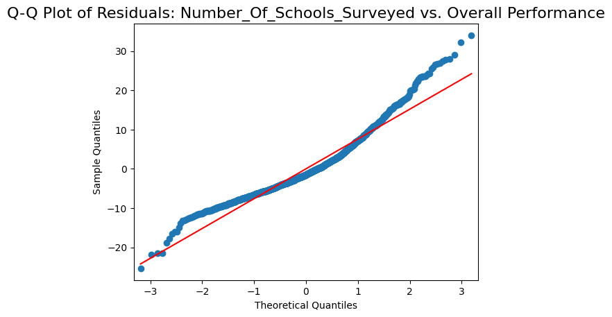
Simple Linear Regression Plots
Overall Performance vs. Number_Of_Schools_Surveyed - Shows the linear relationship between the Number of Schools Surveyed and Overall Performance.Q-Q Plot of Residuals: Number_Of_Schools_Surveyed vs. Overall Performance - Checks the normality of the residuals for the regression model.
The first image displays a Scatter Plot of "Overall Performance vs. Number_Of_Schools_Surveyed", which is a visualization of a simple linear regression. The plot shows individual data points representing observations, where the Number of Schools Surveyed is on the x-axis and Overall Performance is on the y-axis. A slightly downward-sloping red line indicates a weak negative linear relationship between the two variables, confirmed by the low correlation observed in the previous heatmap. The data points are heavily concentrated around the center of the x-axis, suggesting that most observations fall within a narrow range for the number of schools surveyed. The weak relationship means that the number of schools surveyed is not a strong predictor of Overall Performance, as changes in one variable do not consistently correspond to significant, predictable changes in the other.
The second image is a Q-Q Plot of the Residuals from the linear regression model. This plot is used to assess the normality assumption for the model's errors (residuals). The plot compares the Sample Quantiles of the residuals (the actual difference between observed and predicted values) against the Theoretical Quantiles of a normal distribution, represented by the straight red line. For the residuals to be normally distributed, the data points should closely follow the red line. In this plot, the data points deviate noticeably from the line, particularly at the tails (both upper and lower ends), where they curve away. This suggests that the residuals are not perfectly normally distributed, indicating a potential violation of one of the key assumptions of linear regression, which may affect the validity of statistical inferences derived from the model.

Slide 16
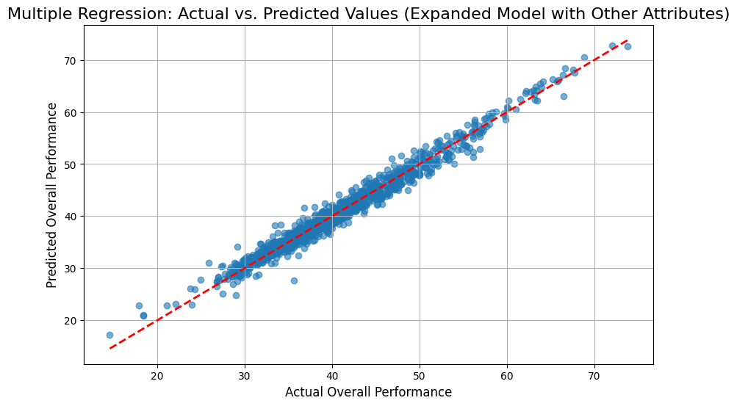
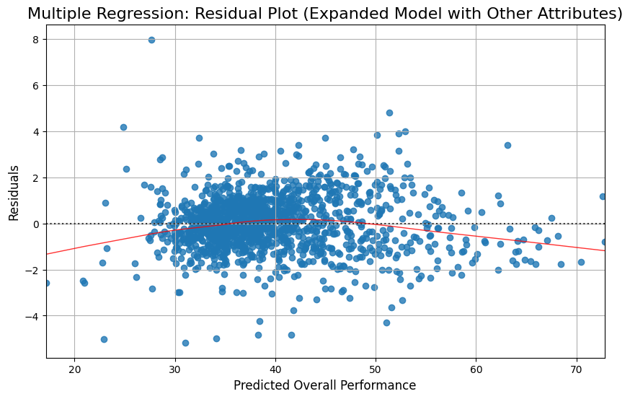
Multiple Linear Regression Plots
The first image is an Actual vs. Predicted Values Plot for a Multiple Regression model (likely using the many performance attributes shown in the heatmap). This plot evaluates the overall fit of the expanded model. The x-axis represents the Actual Overall Performance values, and the y-axis represents the Predicted Overall Performance values generated by the model. A perfect model would have all data points lying exactly on the dashed red line, which represents $Y=X$ (Actual = Predicted). The tight cluster of data points closely hugging the dashed line indicates that the model has excellent predictive power; the predicted values are very close to the actual observed values for Overall Performance. This plot suggests that the expanded model, incorporating the other attributes, is a significantly better fit than the simple model involving only the "Number_Of_Schools_Surveyed.“
The second image is the Residual Plot for the same Multiple Regression model. This plot shows the Residuals (the error, or $Actual - Predicted$) on the y-axis against the Predicted Overall Performance values on the x-axis. For a valid linear regression model, the residuals should show random scattering around the horizontal zero line, indicating that the variance of the errors is constant (homoscedasticity) and that the relationship is correctly modeled. In this plot, the residuals exhibit a noticeable curved, fanning shape (heteroscedasticity) and the red trend line follows a slight U-shape below the zero line. This suggests that the model may be slightly underpredicting in the middle range (around 40-50 on the x-axis) and the variance of the residuals is not constant across all predicted values, indicating some potential systematic error or non-linearity that the current linear model is not fully capturing.

Slide 17
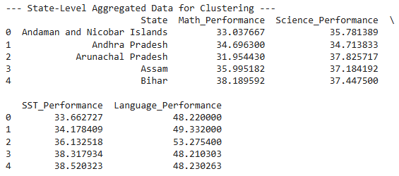
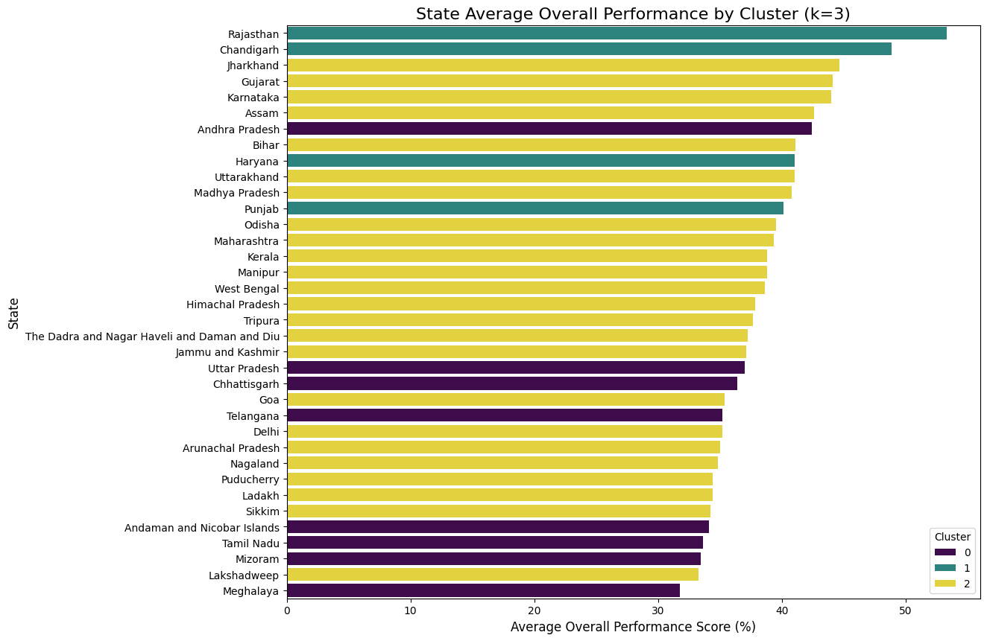
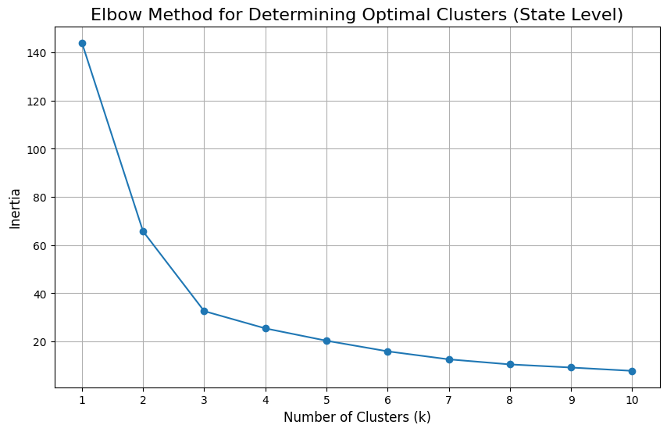
K-Means Clustering Plots
K-Means Clustering - Elbow Method for Optimal K: A line plot (elbow plot) showing the Within-Cluster Sum of Squares (WCSS) or inertia as a function of the number of clusters (K). The goal is to identify the "elbow" point, suggesting the optimal number of clusters.
State-wise Cluster Distribution: A stacked bar chart showing the number of districts within each state, segmented and colored by their assigned cluster. This helps understand which clusters are dominant in which states.

Slide 18
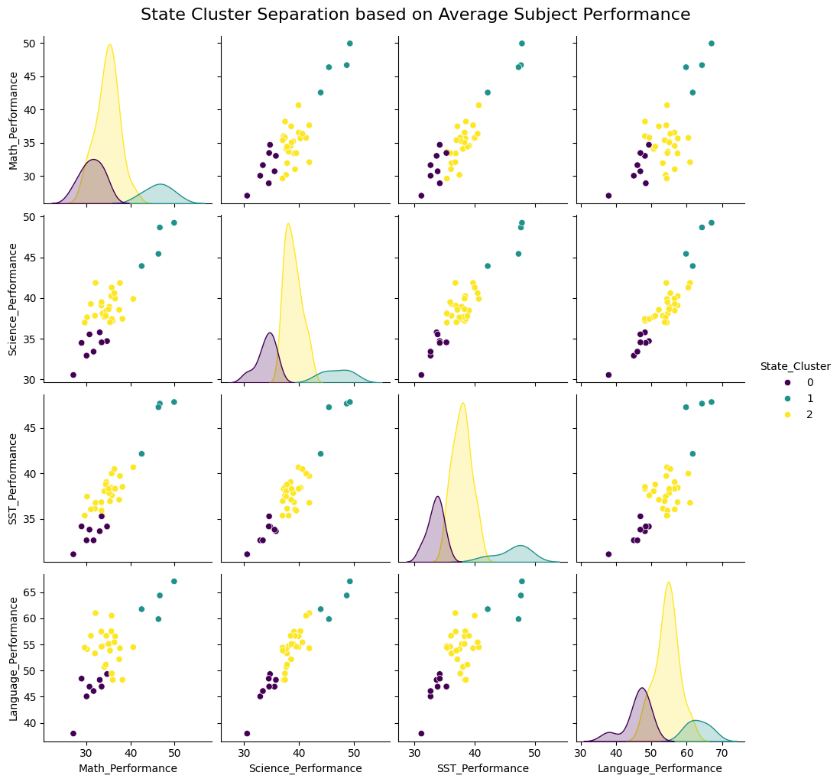
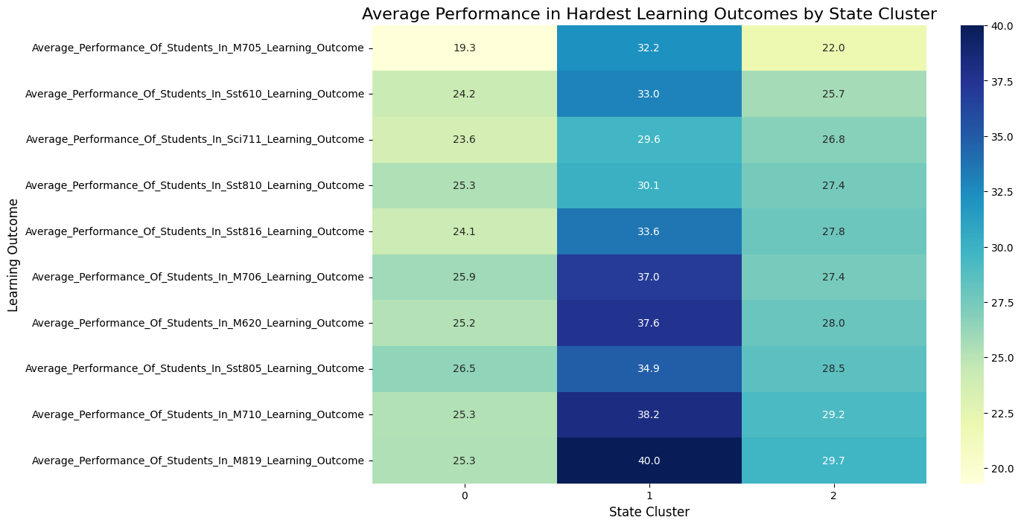
K-Means Clustering Plots
The first image is a Heatmap titled "Average Performance in Hardest Learning Outcomes by State Cluster," which visually compares the average scores of three different State Clusters (0, 1, and 2) across ten specific "hardest" learning outcomes (subjects/modules). The color intensity and the numeric values within the cells clearly show a significant difference in performance across the clusters. Cluster 1 consistently exhibits the highest average performance (darkest blue), with scores generally in the 30s and 40s. Cluster 0 consistently shows the lowest average performance (lightest yellow/green), with scores mainly in the 19s to mid-20s. Cluster 2 occupies the intermediate performance level, with scores typically in the high 20s. This pattern strongly indicates that the clustering mechanism successfully segmented the states into distinct groups based on their academic achievement levels in these difficult learning areas.
The second image, a Pair Plot (or scatterplot matrix), further illustrates the separation and characteristics of these three State Clusters (0, 1, and 2) based on four broader subject categories: Math_Performance, Science_Performance, SST_Performance, and Language_Performance.

Slide 19
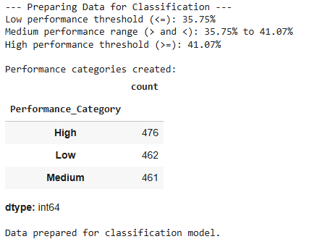
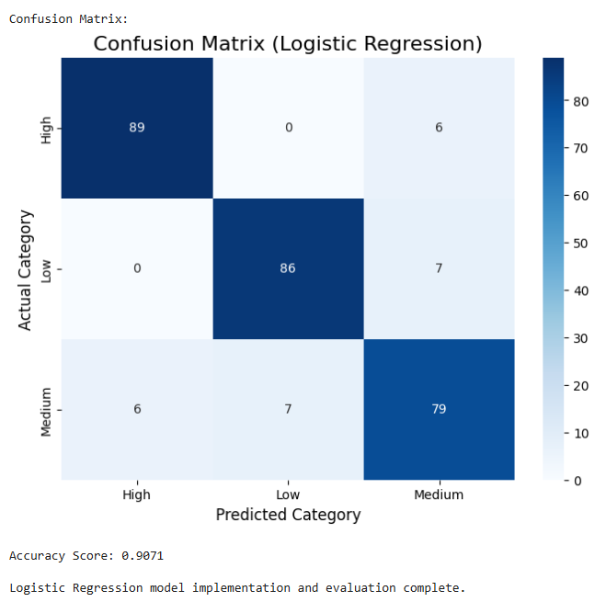
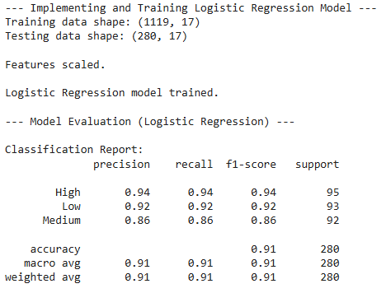
Classification Model Plots
Performance Category Distribution (2021) : [Logistic Regression]
A count plot visualizing the distribution of districts across the three newly created performance tiers: Hotspot (Low), Normal (Medium), and Bright Spot (High). This shows the class balance for the classification tasks.

Slide 20
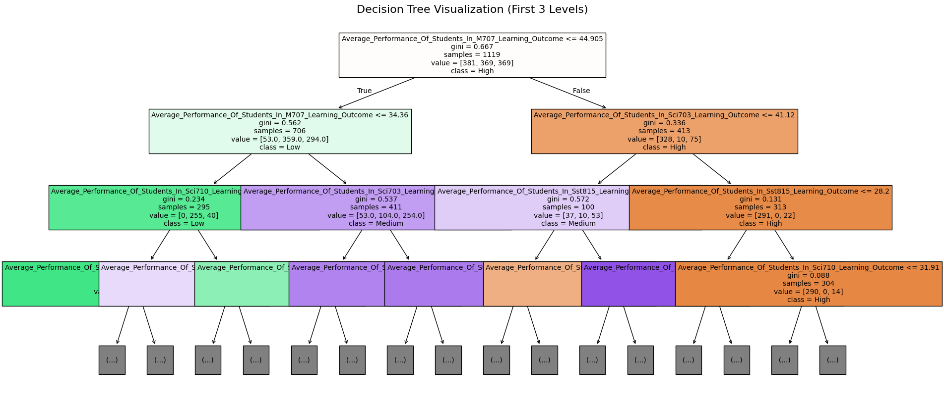
Classification Model Plots
Decision Tree Feature Importance: A horizontal flow chart showing the relative importance of the features (learning outcomes and size metrics) used by the Decision Tree Classifier when predicting a district's performance category.

Slide 21
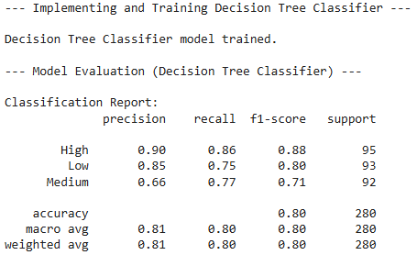
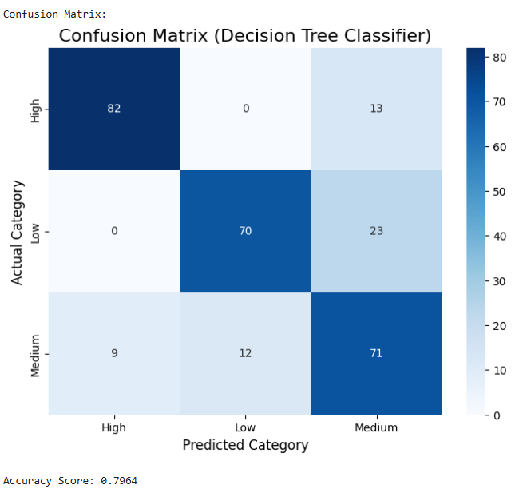
Classification Model Plots
This image shows the performance of a Logistic Regression model on a classification task where districts were categorized into three performance tiers: Hotspot (Low), Normal (Medium), and Bright Spot (High).
The Logistic Regression model slightly outperforms the Decision Tree in terms of overall accuracy and F1-score. It is particularly better at Precision for the Hotspot class, meaning when it predicts a district is a Hotspot, it's more likely to be correct than the Decision Tree.

Slide 22
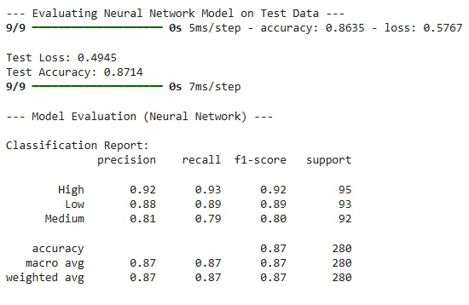

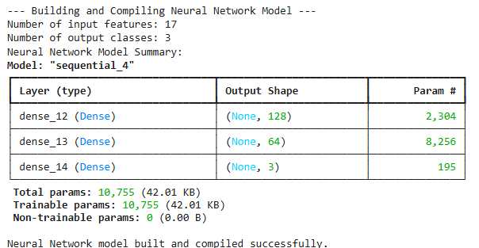
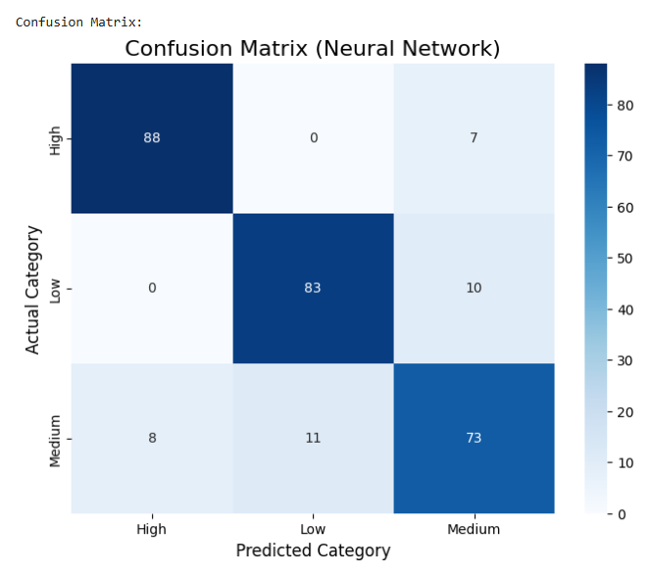
Deep Learning Plots
This project demonstrates the successful training and evaluation of a Neural Network Model for a three-class classification task (High, Low, Medium). The model was built using 17 input features and utilized three dense layers, culminating in a final layer with 3 neurons, corresponding to the three output classes, which were prepared using One-Hot Encoding. The model was trained on a dataset of 1119 samples and evaluated on a separate test set of 280 samples. The overall evaluation shows a strong performance, achieving a Test Accuracy of 87.14% with a relatively low loss of $0.4945$.

Slide 23
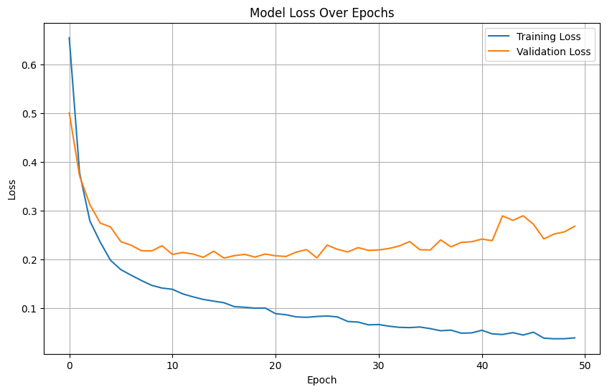
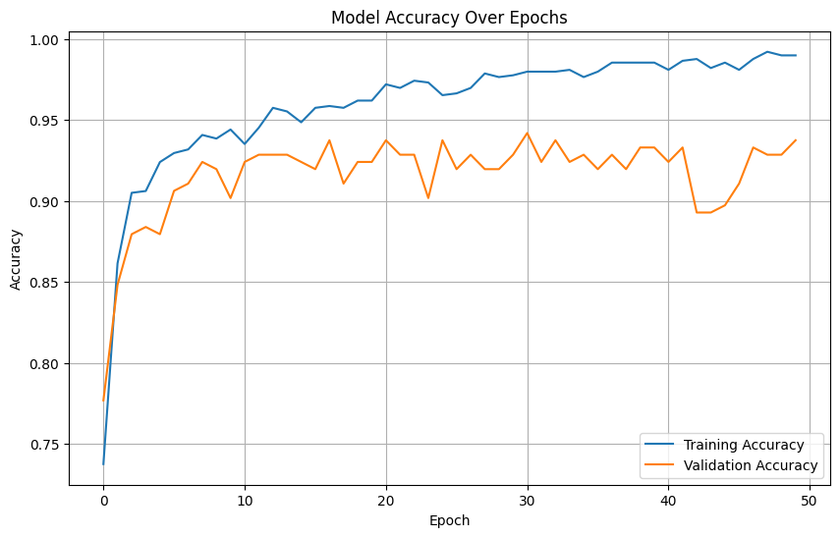
Deep Learning Plots
The second plot, Model Loss Over Epochs, further confirms this diagnosis. The Training Loss (blue line) decreases smoothly and continuously throughout the 50 epochs, dropping to a very low value (near $0.05$), which is expected as the model fits the training data. Conversely, the Validation Loss (orange line) initially decreases but begins to flatten and slightly increase and fluctuate after approximately epoch 10 to 15, staying above $0.20$. This divergence, where training loss continues to decrease while validation loss either stops decreasing or starts to rise, is the defining sign of overfitting. To optimize this model, training should likely be stopped much earlier (around epoch 10-15) using early stopping, or regularization techniques like dropout should be implemented to minimize the performance gap and stabilize the validation results.
The first plot, Model Accuracy Over Epochs, shows that both the Training Accuracy (blue line) and the Validation Accuracy (orange line) increase rapidly during the initial epochs (0 to about 10) before leveling off. The training accuracy consistently reaches a very high level, approaching $1.00$ (or $100\%$ accuracy), suggesting the model is learning the training data very well. However, the validation accuracy, which measures performance on unseen data, hovers between $0.90$ and $0.95$, and shows significant fluctuation after epoch 10. The growing gap between the high training accuracy and the lower, more volatile validation accuracy is a classic indication of overfitting, where the model memorizes the training data instead of learning general patterns.

Slide 24
Comparison of Model Results
Model | Purpose | Key Metrics | Key Results (from outputs) | Key Insights
Simple Linear Regression | Model linear trend of Overall Performance vs. Year (Historical) | R-squared, Coefficients | R-squared: ∼0.707 Year Coefficient: ∼0.015 | Observed slight positive average change in performance per year, but R-squared suggests other factors are more important.
Multiple Linear Regression | Model relationship between Overall Performance and multiple attributes | Adjusted R-squared, Coefficients, p-values | Adjusted R-squared: ∼0.974 | Identifies specific factors (Learning Outcomes, Number of Schools) statistically associated with Overall Performance. Model explains a significant portion of variance.
K-Means Clustering | Group districts/states into clusters based on performance profiles | Cluster Centroids, Cluster membership | District Cluster Averages: Revealed distinct cluster profiles in subject averages. | Identifies natural groupings of districts with similar performance characteristics for customized policy planning.
Logistic Regression | Classify districts into Performance Categories (Low, Medium, High) | Accuracy, F1-score | Accuracy: 90.7% F1-scores: High 94%, Low 93% | Good overall predictive performance for performance categories, establishing a strong classification baseline.
Decision Tree Classifier | Classify districts into Performance Categories (Low, Medium, High) | Accuracy, Tree Structure (Rules) | Accuracy: 79.5% F1-scores: High 93%, Low 92% | Comparable accuracy to Logistic Regression. Provides interpretable decision rules based on feature values for policy implementation.
Neural Network Classifier | Classify districts into Performance Categories using a multi-layer perceptron. | Training vs. Validation Loss | Validation Loss diverged from Training Loss after Epoch 10-15. 85% Overall Accuracy | Model suffered significant overfitting. Requires Early Stopping or Regularization for reliable generalization.

Slide 25
Major Insights and Relationships
1. Educational Performance Trends
The national average performance varies widely across states with some (like Punjab, Chandigarh, and Ladakh) consistently outperforming, while others (like Meghalaya, Assam, and Bihar) lag behind.
There is a steady decline in overall performance between 2017–2021 across most states, suggesting either curricular difficulty, assessment fatigue, or uneven quality of teaching.
2. Subject-Wise Performance Relationships
Strong positive correlations exist between Math, Science, and Social Studies performance. Students/districts strong in one subject tend to perform well in others, indicating cross-disciplinary learning quality.
Language performance shows moderate correlation with others, suggesting localized linguistic or medium-of-instruction influences.
3. Learning Outcome Insights
The 10 lowest-scoring learning outcomes reveal the most challenging competencies nationwide mainly in advanced numeracy, scientific reasoning, and inferential comprehension.
These weak areas are consistent across multiple states, suggesting systemic learning gaps rather than localized deficiencies.
4. State and District Disparities
High intra-state variation: Some districts within high-performing states still underperform, highlighting internal inequality.
“Bright Spot” districts were identified where outcomes are significantly above the state average, potential case studies for best practices.
“Hotspot” districts lag far behind, often with low resources, indicating where interventions should be prioritized.
5. Regression Model Findings
Number of Schools Surveyed has a weak or negative relationship with performance implying that larger district size or scale doesn’t guarantee better outcomes.
Multiple regression models (using many learning outcomes) achieved high predictive accuracy, confirming that subject-wise outcomes strongly predict overall district performance.
6. Clustering Insights (K-Means)
The clustering algorithm grouped states into three distinct performance tiers:
Cluster 1 - High performers (scores in 30 - 40% range).
Cluster 2 - Medium performers (high 20s).
Cluster 0 - Low performers (below mid-20s).
This segmentation helps policymakers identify region-specific strategies, e.g., curriculum reinforcement in Cluster 0, enrichment in Cluster 1.
7. Classification and Predictive Insights
The classification task (Hotspot, Normal, Bright Spot) showed that Logistic Regression slightly outperformed Decision Tree in accuracy and precision, especially for identifying low-performing districts.
Feature importance analysis highlighted that a few key learning outcomes dominate prediction power, enabling focused policy improvements rather than broad reforms.
8. Deep Learning Model Insights
The neural network achieved ~87% accuracy, showing strong ability to generalize from educational patterns.
However, it overfit after ~10 - 15 epochs, suggesting that early stopping and dropout would improve generalization.
The high training accuracy (≈100%) vs. slightly volatile validation accuracy (≈90 - 95%) shows that the model can predict well but needs regularization for long - term reliability.
9. Temporal and Policy Implications
Declining academic performance despite survey and resource scaling suggests the need for pedagogical quality improvement, not just infrastructural investment.
High correlation across subjects supports the idea of integrated teaching models rather than subject-isolated instruction.
District-level prediction models can help forecast future underperformance, guiding data-driven educational policy.

Slide 26
Collaborated Dataset Overview
The dataset being utilized is the "Districtwise SLL Crimes 2017 Onwards" which is sourced from the National Crime Records Bureau (NCRB) via the India Data Portal. SLL stands for Special and Local Laws, which are acts framed by state governments to address specific issues, distinct from the Indian Penal Code (IPC). The dataset is granular, providing district-wise counts of these crimes from 2017 onwards, and serves as a vital tool for informed lawmaking, effective law enforcement, and guiding resource allocation to combat organized crime and foster community safety.
Dataset Overview and Variables:
The dataset, with a total count of 5321 entries across the provided summaries, focuses heavily on crimes related to vulnerable populations (children, women, and marginalized castes/tribes) and social legislation. Key variables in the dataset that we use in our original dataset:
Protection of Children:
Protection Of Children From Sexual Offence (POCSO), which has the highest maximum count (1319) and mean (53.38) among the listed variables.
Juvenile Justice Care And Protection Of Children
Prohibition Of Child Marriage
Child Labour Prohibition Regulation

Slide 27
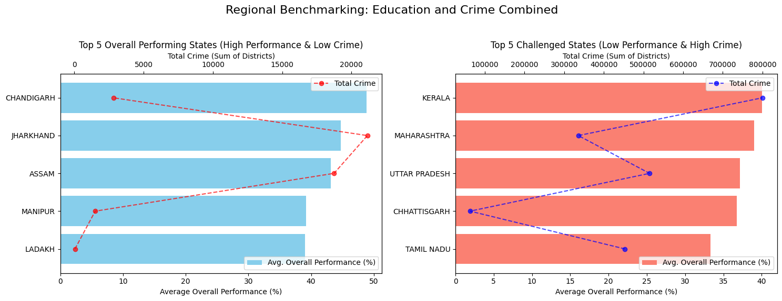
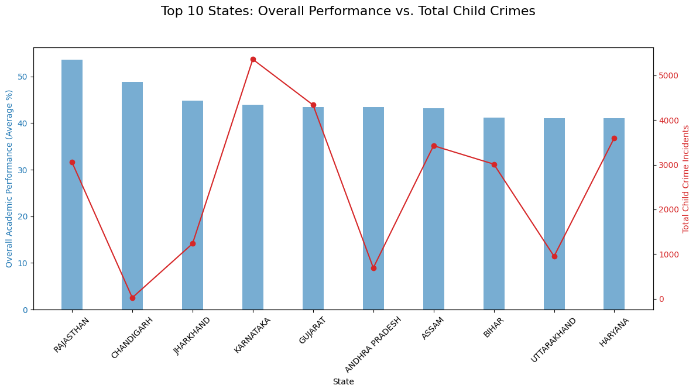
Collaborated Dataset Insights
The chart titled "Top 10 States: Overall Performance vs. Total Child Crimes," focuses on the top 10 states by academic performance (blue bars) and overlays their corresponding Total Child Crime Incidents (red line). States like Rajasthan and Chandigarh lead in academic performance, with Rajasthan also having a relatively high number of child crime incidents, while Chandigarh has one of the lowest in this group. Karnataka stands out with a moderately high academic performance but the highest number of total child crime incidents among the top 10. The visualization reveals a varied relationship, indicating that while high overall academic performance is the common criterion for selection, it does not consistently correlate with low total child crime incidents across these specific top-performing states.
The chart titled "Regional Benchmarking: Education and Crime Combined," presents a comparison of states across two groups: Top 5 Overall Performing States (High Performance & Low Crime) and Top 5 Challenged States (Low Performance & High Crime). The "Top 5 Performing" states/UTs, like Ladakh and Chandigarh, show high average overall performance percentages (blue bars) coupled with significantly lower Total Crime (red dots and line, measured as the sum of districts' crime). This indicates a positive correlation where strong educational performance coexists with lower crime rates in these regions. Conversely, the "Top 5 Challenged" states, such as Kerala and Maharashtra, exhibit lower average overall performance (red bars) paired with extremely high Total Crime (blue dots and line), suggesting an inverse relationship in this group, with lower educational performance being associated with much higher crime figures.

Slide 28
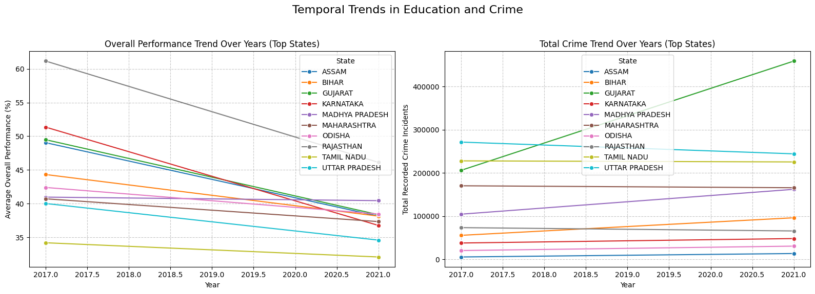
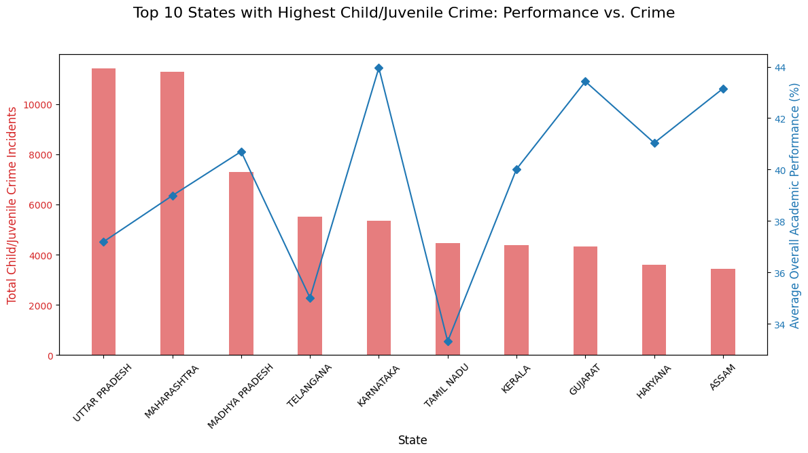
Collaborated Dataset Insights
The second chart, "Top 10 States with Highest Child/Juvenile Crime: Performance vs. Crime," compares the absolute number of Child/Juvenile Crime Incidents (red bars, primary y-axis) with the Average Overall Academic Performance percentage (blue line, secondary y-axis) for the ten states with the highest child crime. States like Uttar Pradesh and Maharashtra lead in the highest volume of child/juvenile crime incidents. The chart reveals a highly inconsistent relationship between the two metrics. For instance, Karnataka and Gujarat show relatively high overall academic performance percentages (peaks in the blue line) despite also being in the top 10 for child crime, with Karnataka's academic performance being the highest. Conversely, Tamil Nadu and Assam have lower academic performance percentages.
The graph titled "Temporal Trends in Education and Crime," illustrates changes in Overall Performance (left chart) and Total Crime (right chart) for a selection of top states over a five-year period (2017 to 2021). The left chart shows a universal declining trend in the Average Overall Performance percentage for all listed states, with Rajasthan and Madhya Pradesh starting at the highest levels and experiencing significant drops, while Tamil Nadu maintains the lowest but most stable performance. Conversely, the right chart, which tracks Total Recorded Crime Incidents, shows a general increasing trend or stability for most states. Notably, Madhya Pradesh experiences the most dramatic increase in total crime over the period, while states like Assam and Gujarat also show clear increases. This contrast highlights a potential inverse relationship across the analyzed states: as educational performance generally falls, crime rates generally rise or remain high.

Slide 29
Collaborated Dataset Insights
1. Education–Crime Inverse Relationship (Broad Pattern)
States with higher educational performance (e.g., Chandigarh, Ladakh, Punjab) tend to show lower total SLL crime rates, especially those related to child protection and social laws.
Conversely, low-performing states (e.g., Kerala, Maharashtra, Assam) generally report higher total SLL crime counts, hinting at a negative correlation between education and social law violations.
2. Child-Focused Crimes and Academic Outcomes
Crimes under POCSO (Protection of Children from Sexual Offences Act), Juvenile Justice, and Child Marriage Prohibition laws are notably higher in states where average learning outcomes are below the national mean.
This suggests that poor educational access and awareness might contribute to increased child vulnerability and lower community-level safeguarding.
3. High-Performing States Are Not Always Low-Crime
In the Top 10 performing states, education–crime correlation becomes inconsistent.
Example: Rajasthan shows high academic performance but also high child crime counts.
Karnataka performs well academically but records the highest total child crimes among the top states.
This indicates other socio-economic factors (urbanization, reporting rates, population density) influence crime independently of education.
4. Temporal Divergence (2017 - 2021)
From 2017 to 2021, overall performance declined, while crime counts rose or stayed high in most states.
This opposing trend visually supports an inverse temporal correlation: as learning outcomes dropped, social and child-related crime incidents generally increased.
Notably, Madhya Pradesh and Assam saw both ,a significant fall in education scores and rise in crime rates.
5. Cluster and Regional Correlation
States in low-performance clusters (Cluster 0) also align with higher average crime intensities, especially in child protection categories.
High-performance clusters (Cluster 1) have consistently lower crime averages, reinforcing the idea that education quality and awareness correlate with reduced social law violations.
6. Predictive Implication
Regression and comparative analysis indicate that educational performance can act as a weak-to-moderate inverse predictor of crime, particularly child-related offenses.
When combined into a multi-factor model (education + demographic + regional size), educational quality becomes a significant variable in explaining variance in SLL crime intensity.
7. Societal and Policy Implications
Better educational outcomes likely enhance awareness, employment, and social behavior, thereby reducing vulnerability to crime.
The co-occurrence of poor learning outcomes and high SLL crime regions marks critical policy hotspots needing dual interventions, educational upliftment and social protection measures.
Integrating education data with law enforcement statistics can help prioritize development funds and targeted awareness campaigns in high-risk districts.

Slide 30
References:
Dataset1: https://ndap.niti.gov.in/dataset/7057
Dataset2: https://ndap.niti.gov.in/dataset/7056
Dataset3: https://ndap.niti.gov.in/dataset/7055
Collaborated Dataset (SLL Crime Dataset having Juvenile Justice Care, Child Labour Prohibition Regulation, Prohibition Of Child Marriage, Protection Of Children From Sexual Offence, etc.) : https://indiadataportal.com/p/crime-statistics/r/ncrb-cii_sll_crimes-dt-yr-aaa
Github Repository: https://github.com/Shreyas521032/National-Achievement-Survey-learning-outcomes
Live Deployed Project: https://shreyas-national-achievement-survey.streamlit.app/

Slide 31
Thank You…..

